Slide 1


Slide 2
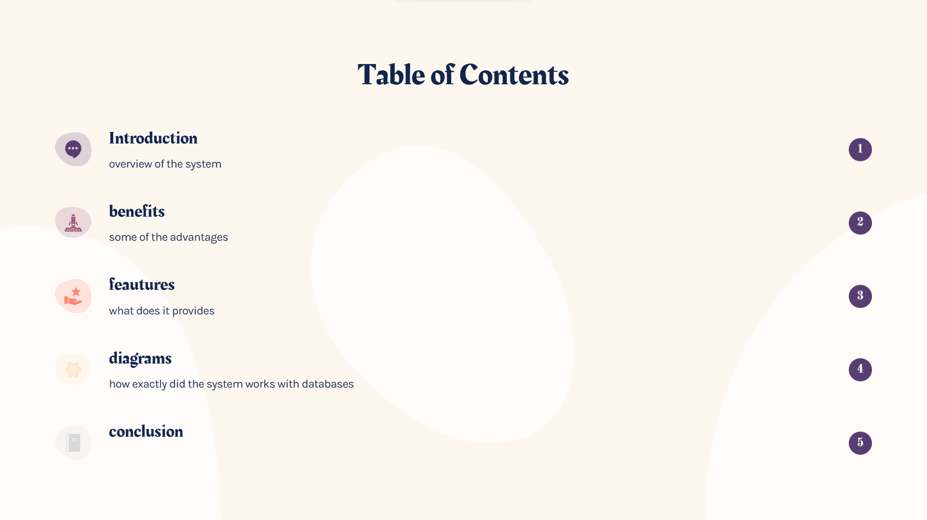

Slide 3


Slide 4


Slide 5


Slide 6
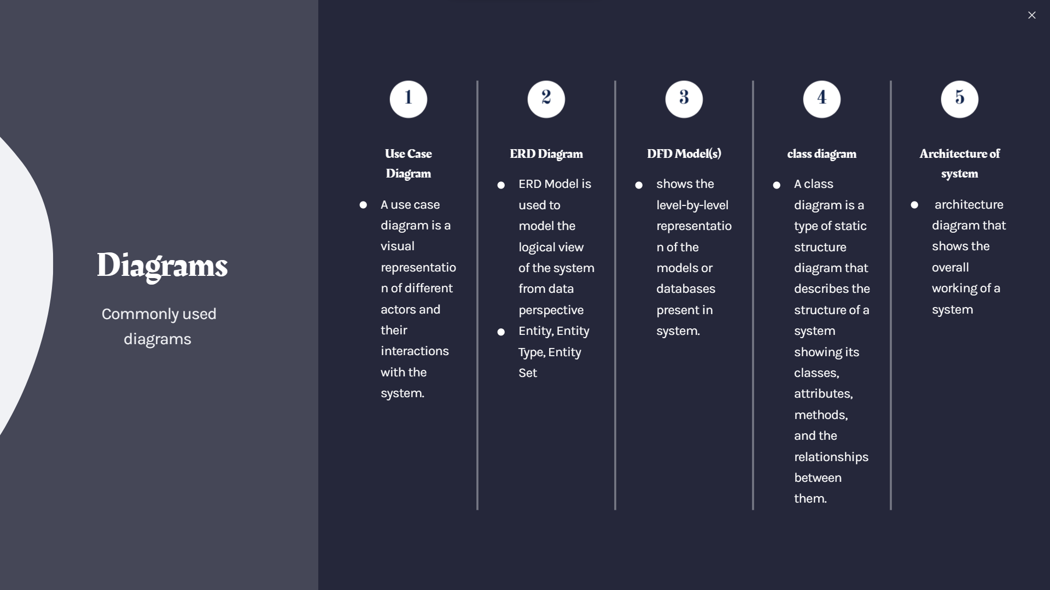

Slide 7
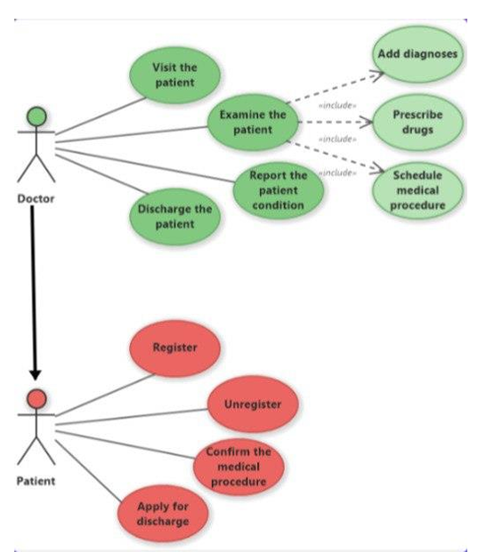
Use Case Diagram

Slide 8
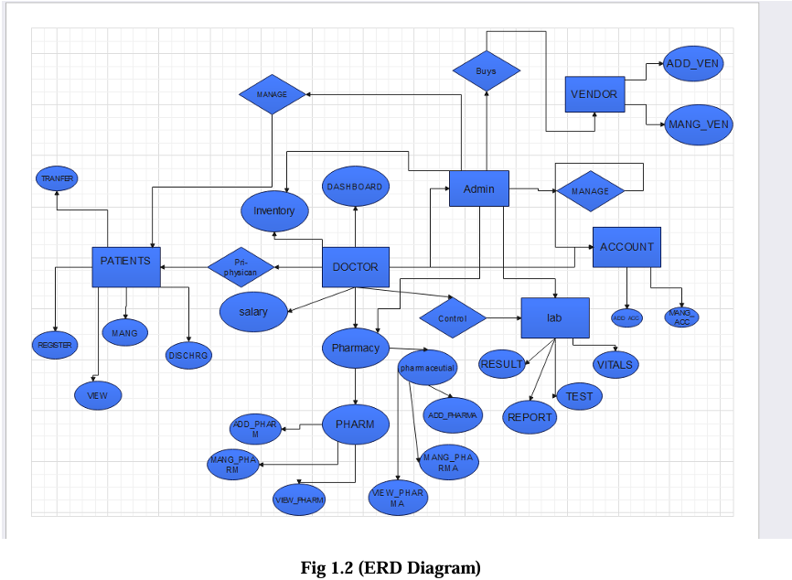
ERD Diagram

Slide 9
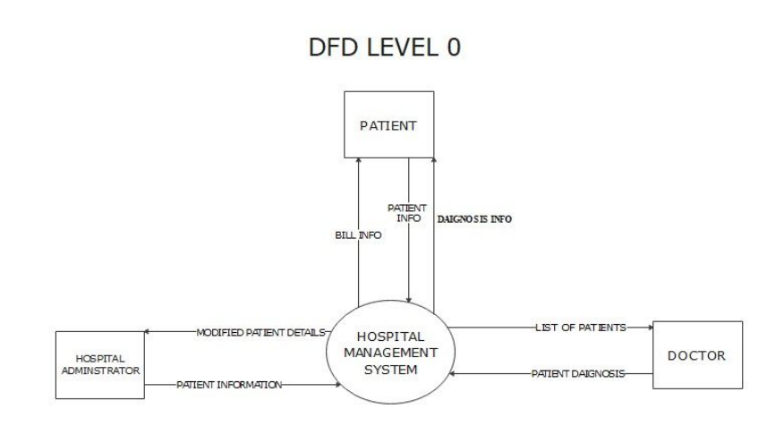
DFD Level 0

Slide 10
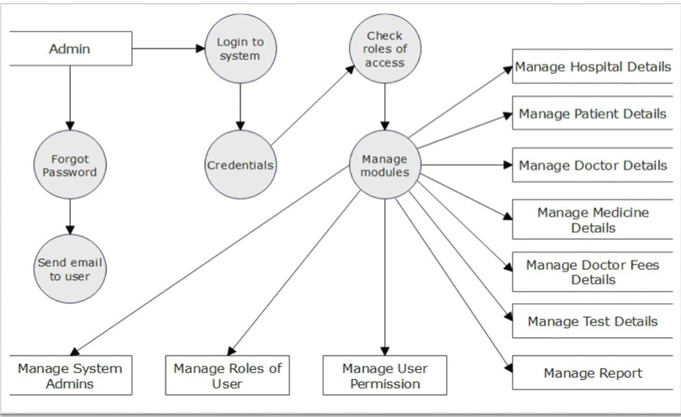
DFD Level 1

Slide 11
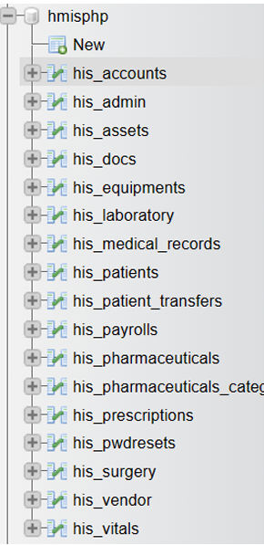
DB NAMES

Slide 12

HOSPITAL SYS

Slide 13
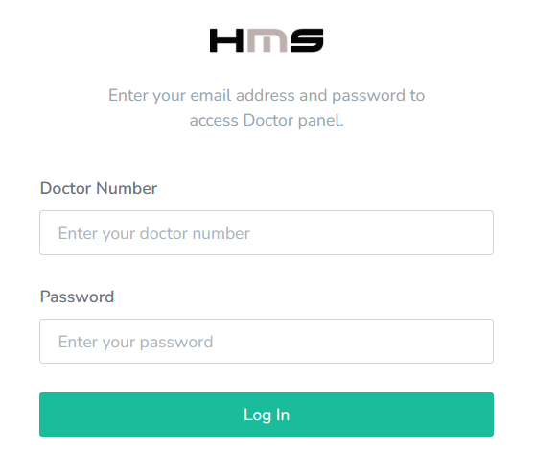
HOSPITAL SYS

Slide 14
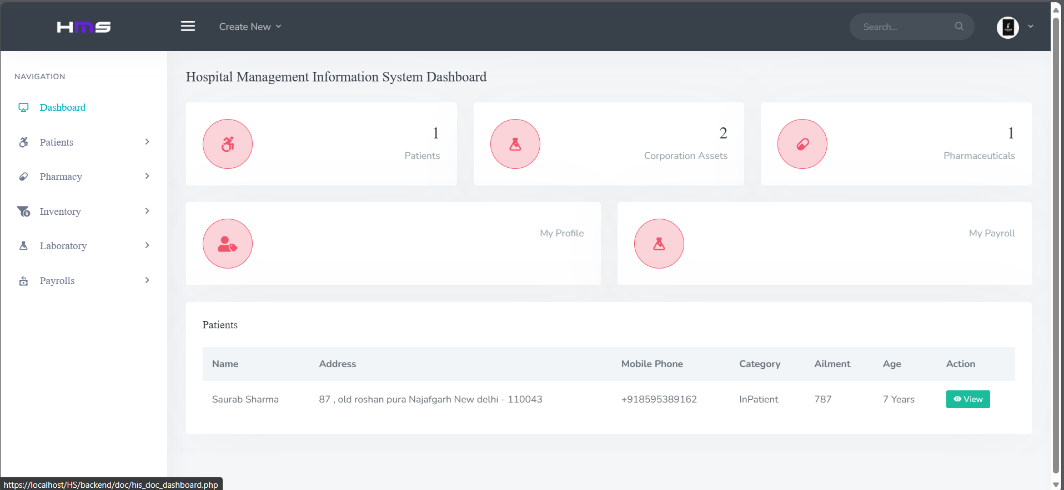
HOSPITAL SYS

Slide 15
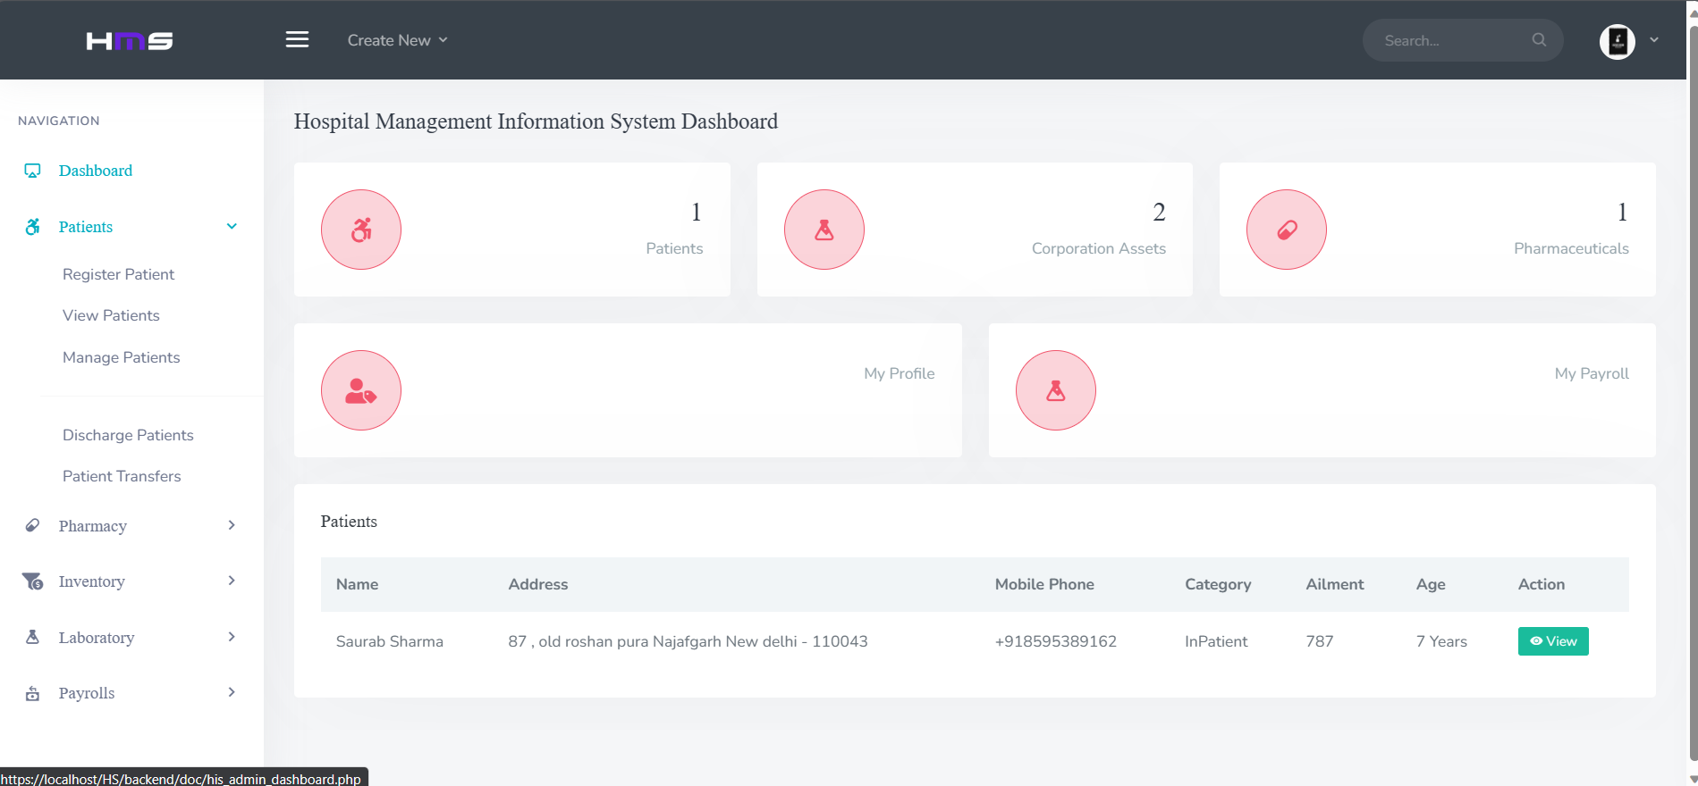
HOSPITAL SYS

Slide 16


